Slide 1
Code Cash
Presentation

Slide 2
Contents of this template
Idea About us Tech Stack Implementation

Slide 3




Our team
Kristian Rusev – Frontend developer
Nikolay Yanakiev – Frontend developer
Georgi Dimitrov – Frontend developer
Aleksandar Stanev – scrum trainer

Slide 4
The idea
Code Cash is a console app to track and manage personal finances. It helps users log income, expenses, set budgets, and track savings goals—all from the terminal.

Slide 5



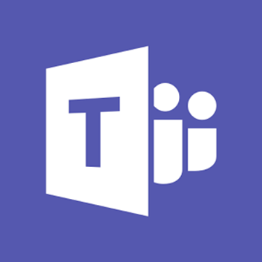
Tech Stack

Slide 6
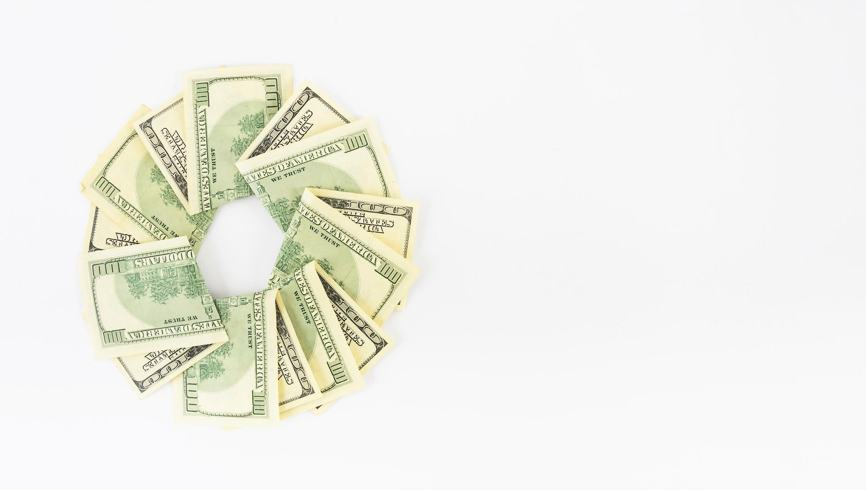
Implementation
We built our application from the ground up in the span of one week, meaning that our project will hopefully be deemed successful.
This time around though, our time for set up and organization could have gone better. That however didn’t discourage us from working stably throughout the rest of our given time.

Slide 7
Thanks for listening

